Slide 1
Computational Modeling
Week 4 (03/05)
Sai Yadavalli, Srihas Surapaneni, Dr. Browning

Slide 2
AGENDA (03/05)
01
02
03
04
Warm Up
MatPlotLib Recap +
Intro to NumPy
Pendulum Example
Homework

Slide 3
WARM UP

Slide 4
Python Warm Up
THE PROBLEM:
Given a string, return a new string where the first and last characters have been exchanged.
EXAMPLE OUTPUTS:
front_back('code') → 'eodc'
front_back('a') → 'a'
front_back('ab') → 'ba'
CHECK YOUR WORK AT:
https://tinyurl.com/mr3z2cfx

Slide 5
02: MatPlotLib Review + NumPy Introduction

Slide 6
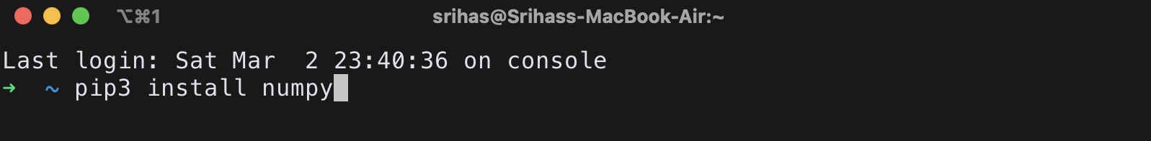
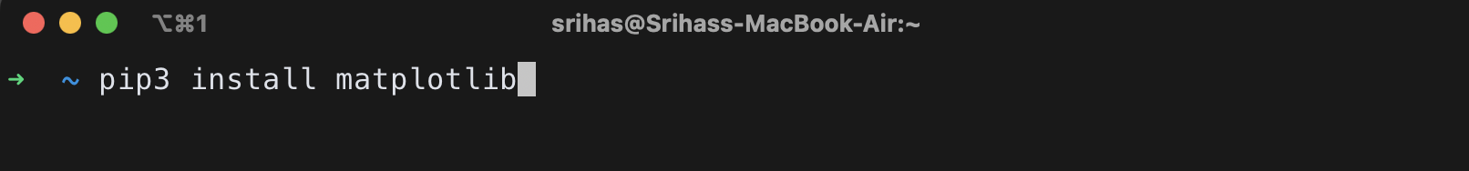
Installing MatPlotLib and NumPy

Slide 7
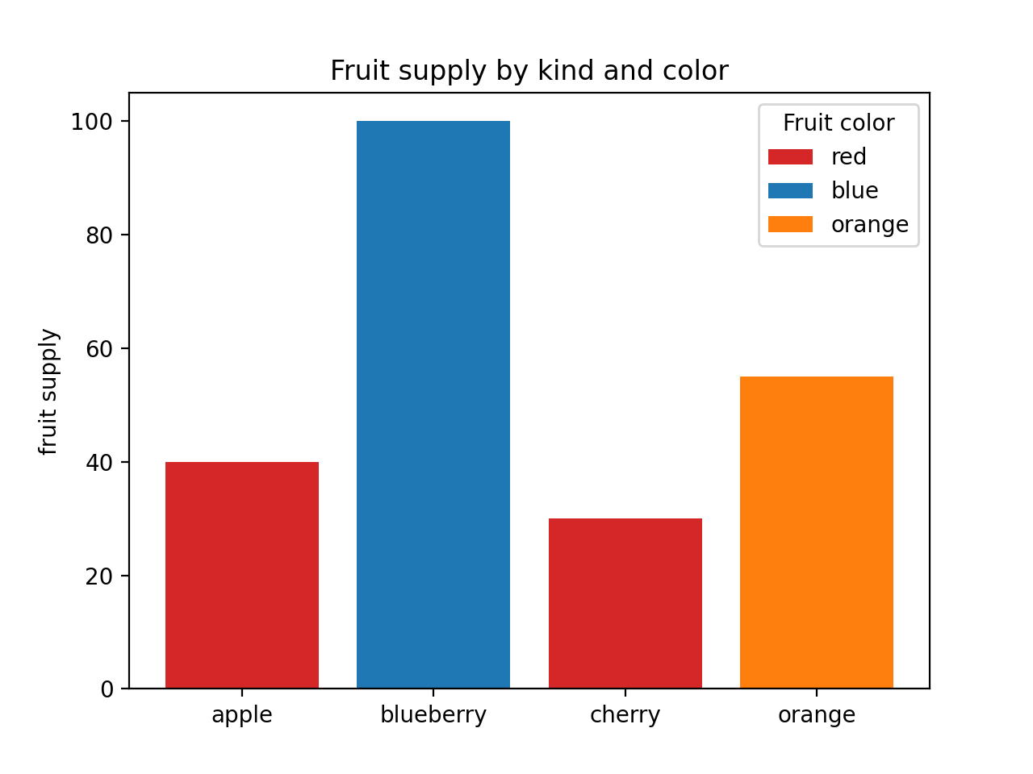
MatPlotLib Recap
A typical Matplotlib plot consists of several components:
Figure:
The entire window or page that contains the plot. (plt.figure())
Axes:
The area where data is plotted. A figure can have one or more axes. (plt.subplot(), plt.subplots())
Axis:
The number line-like objects that define the boundaries of the data area. (plt.xlabel(), plt.ylabel(), plt.xticks(), plt.yticks())
Title:
A descriptive title that explains the purpose of the plot. (plt.title())
Labels:
Descriptive labels for the x-axis and y-axis.
Legend:
An optional component that helps identify different data series. (plt.legend())
Grid:
Optional gridlines that aid in reading the plot. (plt.grid())

Slide 8
NumPy
NumPy is a Python library designed to facilitate efficient numerical operations, particularly with extensive arrays and matrices of data.
It offers optimized tools for mathematical computations, significantly enhancing computational performance compared to native Python data structures.
This functionality is particularly beneficial for scientific computing tasks, including data modeling and visualization.
Through NumPy users can effectively manage large datasets and create insightful visual representations of their data.
NumPy provides a powerful framework for numerical computation, enhancing the capabilities of students in exploring and analyzing mathematical concepts.

Slide 9
03: Pendulum Model

Slide 10
Formulas
Let’s start with the basics:
Angular Acceleration:
dω​/dt​=−L*g*​sin(θ)
Where:
dt/dω represents the rate of change of the angular velocity
ω with respect to time
t, which is the angular acceleration.
L represents the length of the pendulum.
θ represents the angular displacement of the pendulum from the vertical position.
Angular Velocity (ω):
d𝜃/dt = ω
Angular Displacement(θ):
θ(t)=θ₀ * cos(ω⋅t)

Slide 11
Formulas
dt:
dt represents the change in time during each time step in the numerical integration process.
It is typically a small, constant value representing the interval of time between successive calculations of the pendulum's motion.
In numerical methods like Euler's method or the Runge-Kutta method, the value of
dt determines the precision and accuracy of the simulation. Smaller values of
dt generally lead to more accurate results but may require more computational resources.
dθ:
dθ represents the change in angular displacement during each time step.
It is the derivative of the angular displacement θ with respect to time t, indicating how the angle changes over time.
In the context of numerical integration, dθ is computed based on the current angular velocity ω multiplied by the time step dt.
It is a key component in updating the angular displacement of the pendulum at each time step, allowing us to approximate the motion of the pendulum over time.

Slide 12
Open VS Code and Let’s get Started

Slide 13
If you want to learn more…
Euler’s method with python in-depth explanation:
https://www.youtube.com/watch?v=dhhVAaTptfk
Pendulum motion:
https://en.wikipedia.org/wiki/Pendulum_(mechanics)

Slide 14
THANK YOU

